Slide 1
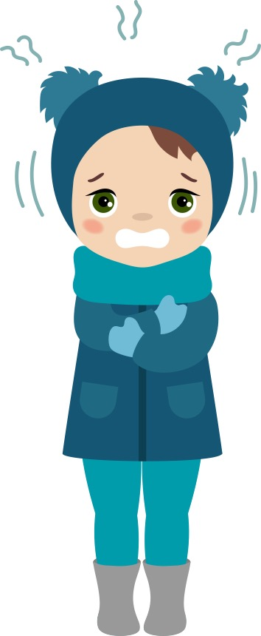

Tha i fuar an-diugh.
Tha i fuar an-diugh.
Tha i fuar,
O tha i fuar,
O tha i fuar an-diugh.
Notes:
It is cold today.
It is cold today.
It is cold, oh it is cold
Oh it is cold today.

Slide 2
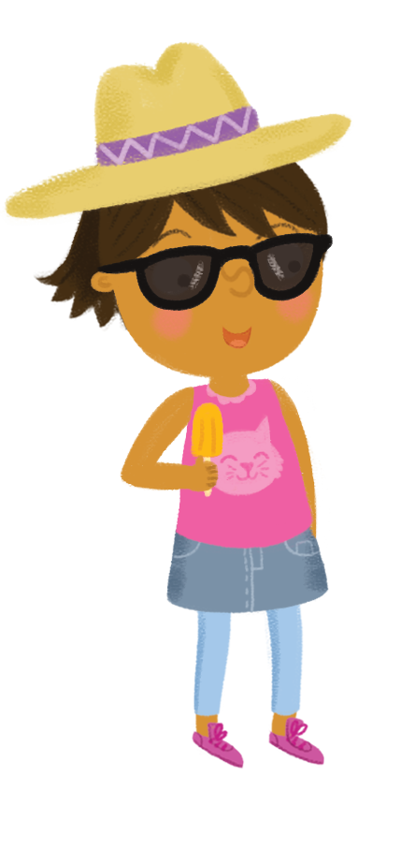


Tha i brèagha an-diugh.
Tha i brèagha an-diugh.
Tha i brèagha,
Tha i brèagha,
Tha i brèagha an-diugh.
Notes:
It is lovely today.
It is lovely today.
It is lovely,
It is lovely
It is lovely today.

Slide 3


Tha i fliuch an-diugh.
Tha i fliuch an-diugh.
Tha i fliuch,
O tha i fliuch,
O tha i fliuch an-diugh.
Notes:
It is wet today.
It is wet today.
It is wet
Oh it is wet
Oh it is wet today.

Slide 4

Tha i sgòthach an-diugh.
Tha i sgòthach an-diugh.
Tha i sgòthach,
Tha i sgòthach,
Tha i sgòthach an-diugh.
Notes:
It is cloudy today.
It is cloudy today.
It is cloudy,
It is cloudy,
It is cloudy today.

